Slide 1
Pixel 3 GMS App Investigations
Part 1: GMS Messaging
Notes:
https://digitalcorpora.s3.amazonaws.com/corpora/mobile/android_10/Non-Cellebrite%20Extraction/Pixel%203.zip

Slide 2
Background

Slide 3

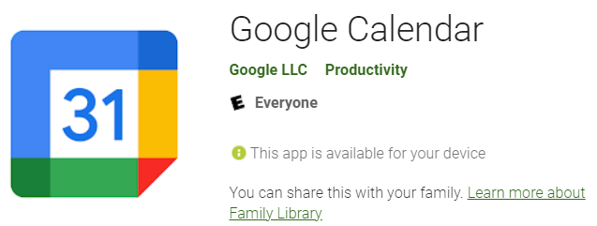
Google Mobile Services (GMS)
GMS is a collection of Google applications and APIs
Google proprietary/native application
GMS helps support functionality across devices.
These apps work together seamlessly to ensure your device provides a great user experience right out of the box.
GMS package pattern: com.google.android.calculator
Notes:
https://www.android.com/gms/

Slide 4

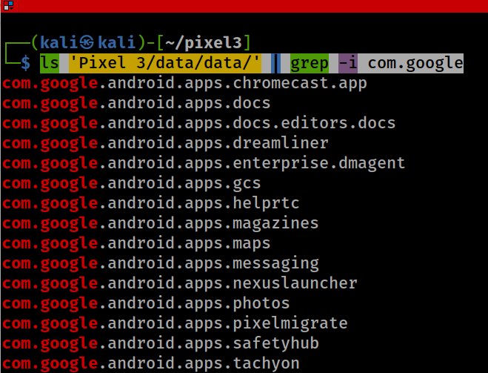
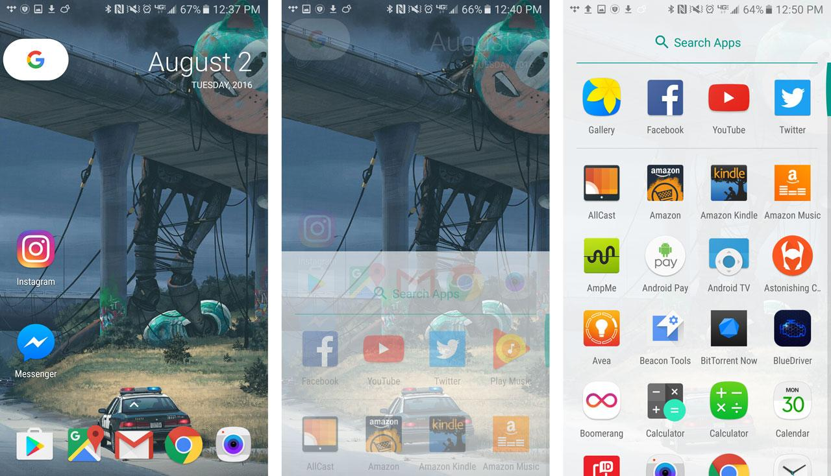
Show all Google GMS Apps: com.google.*
‘dreamliner’ wireless charging widget support
Notes:
ls 'Pixel 3/data/data/' | grep -i com.google

Slide 5



Investigating 3 GMS Apps
Investigating Google Messages
com.google.android.apps.messaging
Investigating Google Maps
com.google.android.apps.maps
Investigating Google Photos
com.google.android.apps.photos

Slide 6
Investigating Google Messages

Slide 7
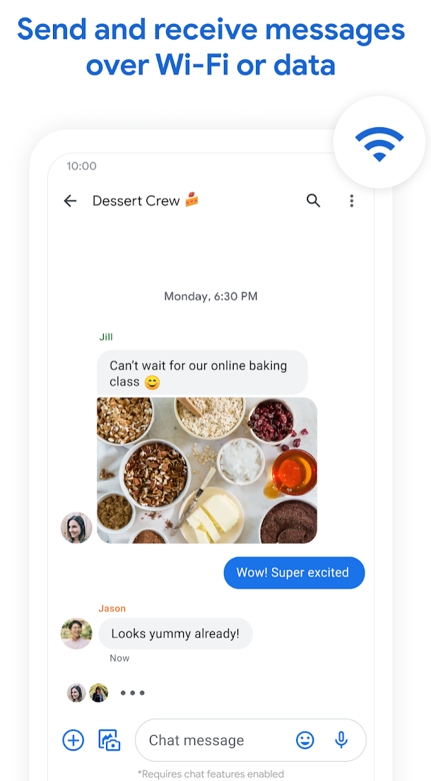
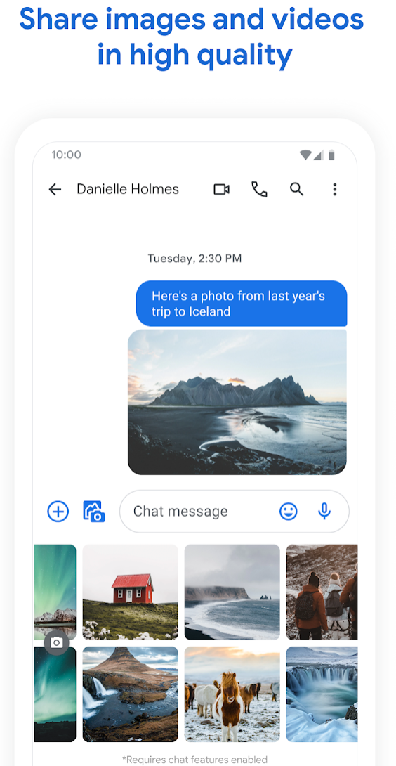
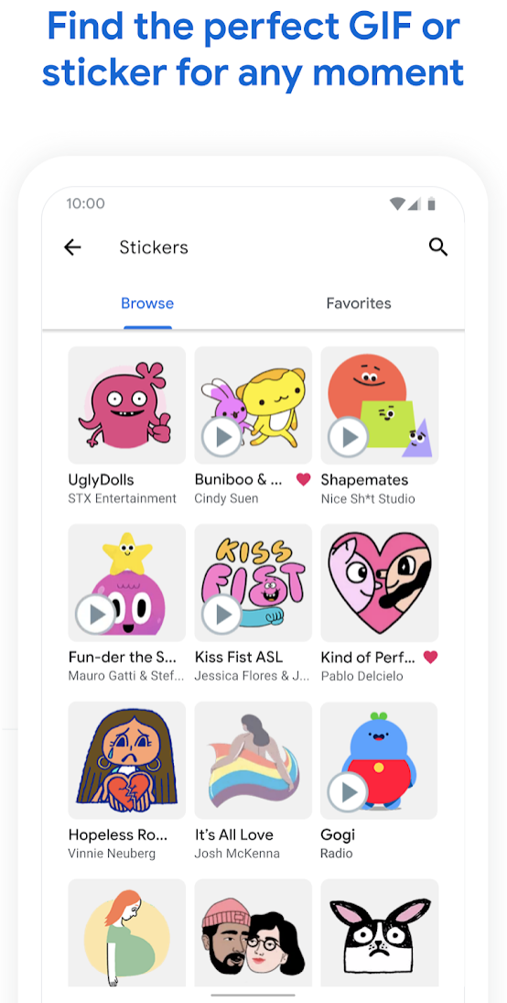
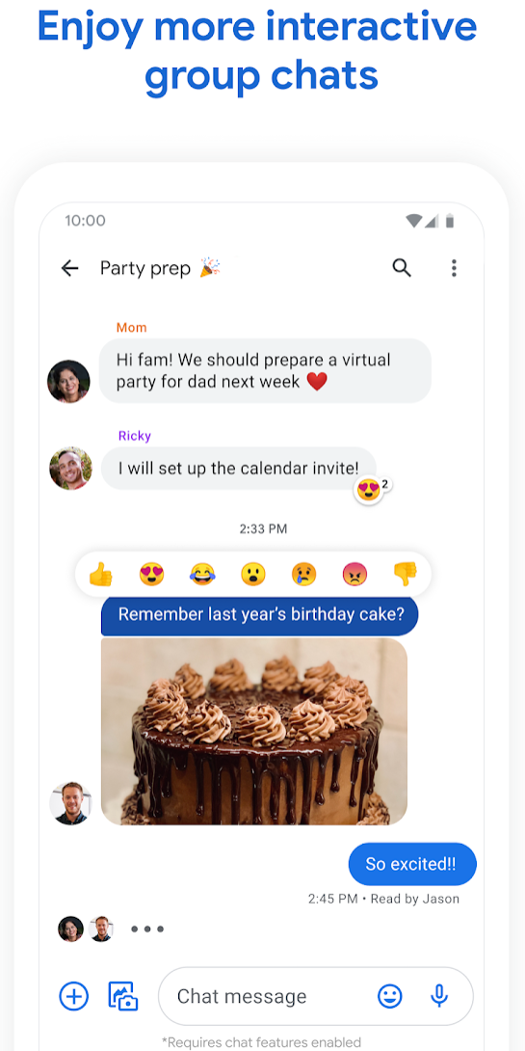
What is Google Messages?

Slide 8
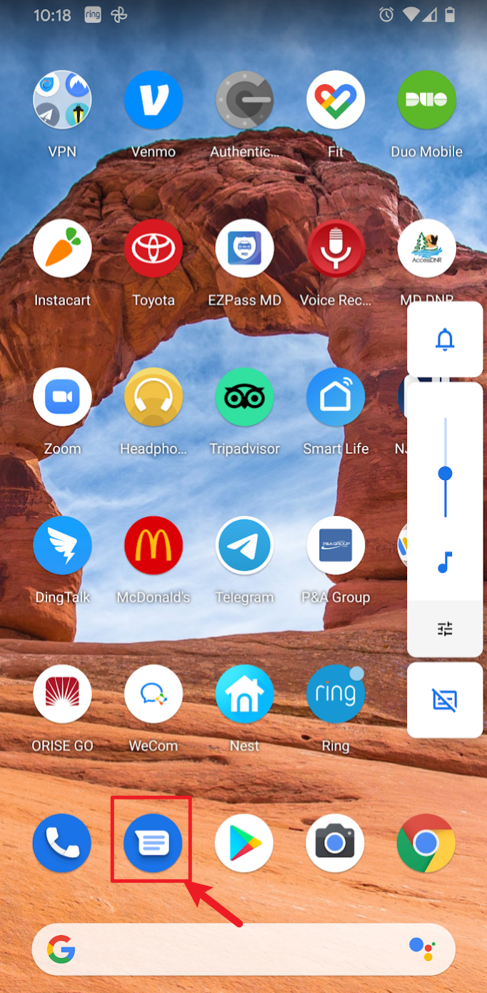
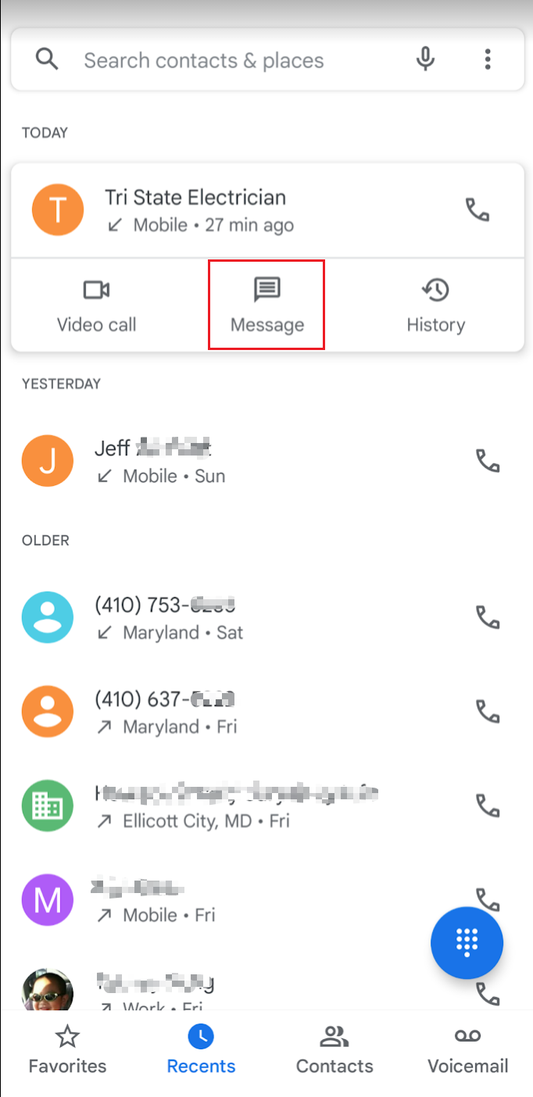
How to invoke Google Messages
Option 1
Option 2

Slide 9
Google Messages vs. AOSP messaging function of telephony service
Feature | Google Messages | AOSP Messaging
Rich Communication Services (RCS) Support | Yes | No
SMS/MMS Support | Yes | Yes
Web Interface | Yes | No
Smart Features | Yes (spam protection, suggestions) | No
End-to-End Encryption | Yes (for RCS) | No
Customization | Themes, chat bubbles | Minimal
Integration | Google Services | None
Resource Usage | Higher | Lower
Availability | Pre-installed or Play Store | Stock Android or custom ROMs
RCS: read receipts, typing indicators, high-quality media sharing, and group chats over Wi-Fi or mobile data

Slide 10
Sample questions
What is the content of the message the phone received on Jan 29, 2020, at 06:20:45 pm?
Who sent the message?
Has the message been read?

Slide 11
Google Messages Data Directory Structure

Slide 12
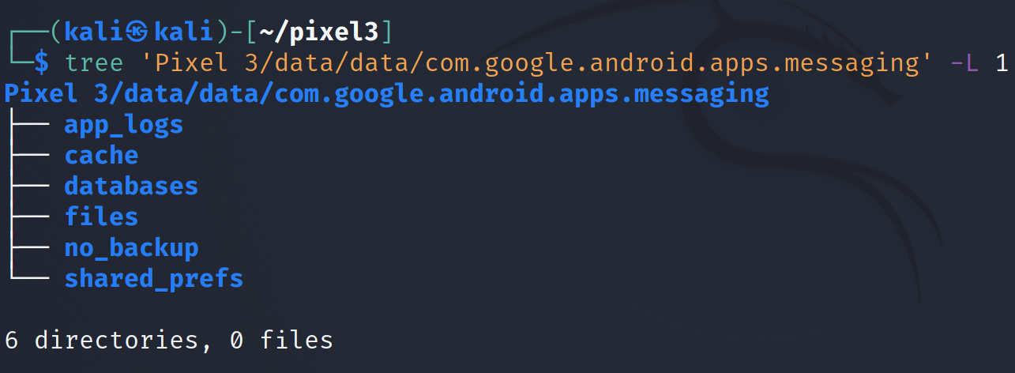
Show Google Messaging data directory structure
-L: Level
messages, contacts, etc.
downloaded attachments (e.g., images, videos), configuration files, or other app-specific data that doesn't fit into the database categories.
Notes:
Cmd: tree 'Pixel 3/data/data/com.google.android.apps.messaging' -L 1

Slide 13
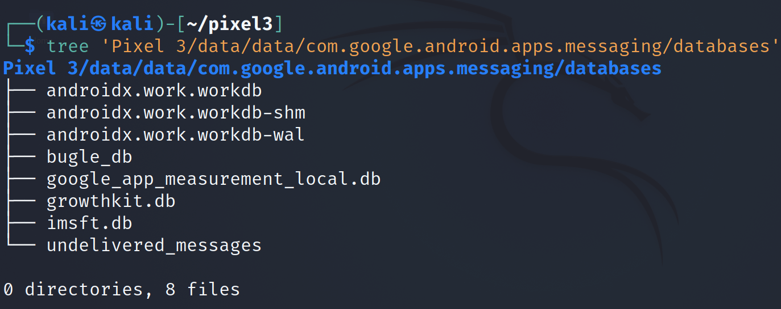
Show Google Messaging database
Notes:
Cmd: tree 'Pixel 3/data/data/com.google.android.apps.messaging/databases'

Slide 14
bugle_db

Slide 15
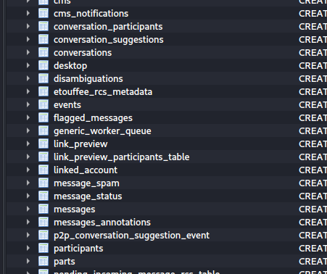
tables in bugle_db
Table contains a set of messages
Table contains messages and metadata (e.g., timestamps)
Notes:
Cmd: sqlitebrowser 'Pixel 3/data/data/com.google.android.apps.messaging/databases/bugle_db'

Slide 16
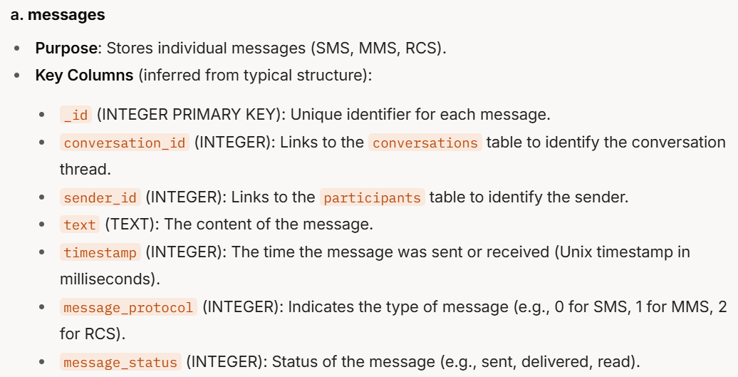
same as sms_message_uri column
Point to SMS database (mmssms.db).
Notes:
a. messages
Purpose: Stores individual messages (SMS, MMS, RCS).
Key Columns (inferred from typical structure):
_id (INTEGER PRIMARY KEY): Unique identifier for each message.
conversation_id (INTEGER): Links to the conversations table to identify the conversation thread.
sender_id (INTEGER): Links to the participants table to identify the sender.
text (TEXT): The content of the message.
timestamp (INTEGER): The time the message was sent or received (Unix timestamp in milliseconds).
message_protocol (INTEGER): Indicates the type of message (e.g., 0 for SMS, 1 for MMS, 2 for RCS).
message_status (INTEGER): Status of the message (e.g., sent, delivered, read).

Slide 17
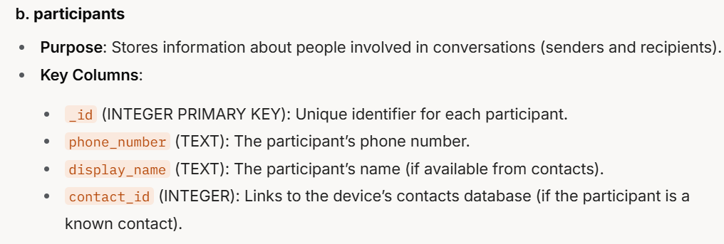
Notes:
b. participants
Purpose: Stores information about people involved in conversations (senders and recipients).
Key Columns:
_id (INTEGER PRIMARY KEY): Unique identifier for each participant.
phone_number (TEXT): The participant’s phone number.
display_name (TEXT): The participant’s name (if available from contacts).
contact_id (INTEGER): Links to the device’s contacts database (if the participant is a known contact).

Slide 18
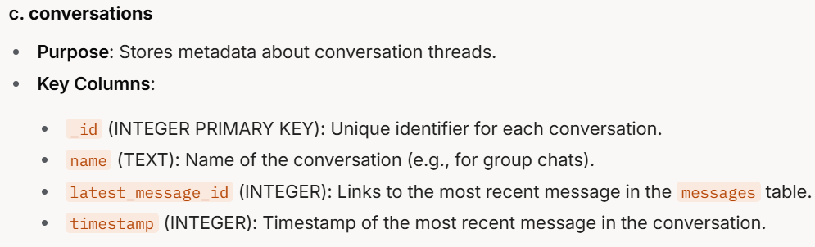
Notes:
c. conversations
Purpose: Stores metadata about conversation threads.
Key Columns:
_id (INTEGER PRIMARY KEY): Unique identifier for each conversation.
name (TEXT): Name of the conversation (e.g., for group chats).
latest_message_id (INTEGER): Links to the most recent message in the messages table.
timestamp (INTEGER): Timestamp of the most recent message in the conversation.

Slide 19
messages table

Slide 20
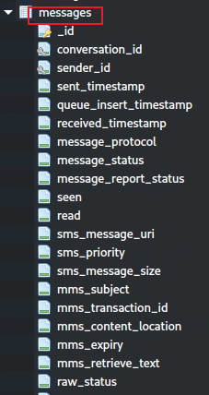
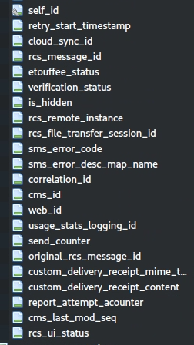
Valuable columns (1)
conversation_id: links the message to a specific conversation thread.
sender_id: Identifies the sender of the message, typically a foreign key linking to a contacts or participants table.
sent/receive_timestamp: the timestamp when the message was sent.
message_protocol: the protocol used for the message (e.g., SMS, MMS, or RCS).
message_status: tracks the delivery status of the message (e.g., sent, delivered, failed).
seen: indicating whether the user has viewed the message.
read: indicating whether the message has been marked as read. Similar to seen, but often tied to RCS read receipts

Slide 21
Valuable columns (2)
ms_message_uri (for SMS): the URI of the SMS message in the Android Telephony Provider (e.g., content://sms/123 in mmssms.db).
mms_subject (for MMS): the subject line of an MMS message, if applicable.
mms_content_location (for MMS): the URL or location where the MMS content (e.g., images, videos) can be downloaded from the carrier’s server
rcs_message_id (for RCS): identifier for RCS messages, used to track messages in RCS systems.
etouffee_status (for RCS): Indicates the encryption status of an RCS message (likely related to "Etouffee," a codename for RCS end-to-end encryption in Google Messages)
raw_status: the raw status of the message as reported by the underlying system (e.g., carrier or RCS server).

Slide 22
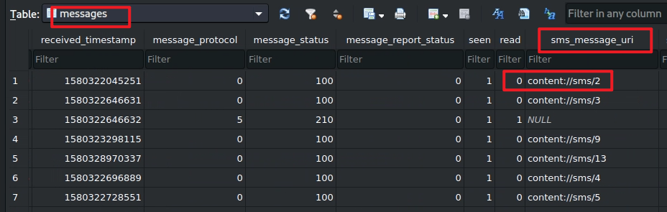
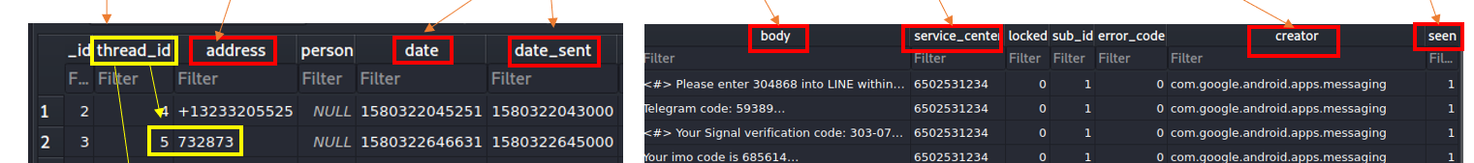

messages table content
Point to sms table in mmssms.db of com.android.provider.telephony.

Slide 23
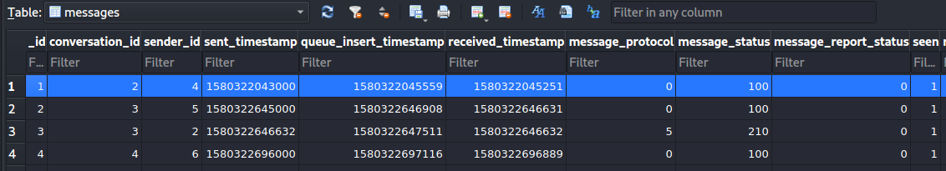
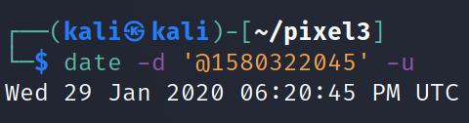
The timestamp of Message received

Slide 24
Find conversation id
conversation_id=2

Slide 25
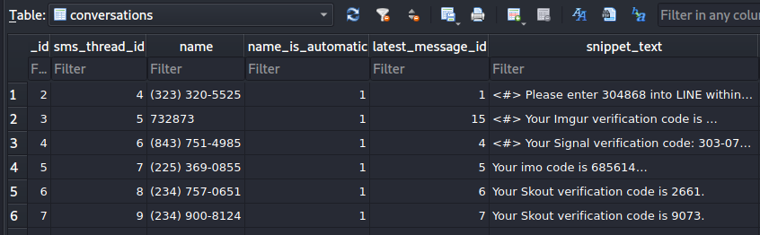
name of the conversation
Solution: message content sent on Jan 29, 2020 at 06:20:43 pm
Find _id=2 in conversations table

Slide 26
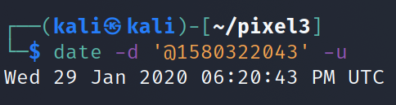
When was the message sent by the other person?
The timestamp of Message sent

Slide 27
link to participate table
Who sent the message?

Slide 28
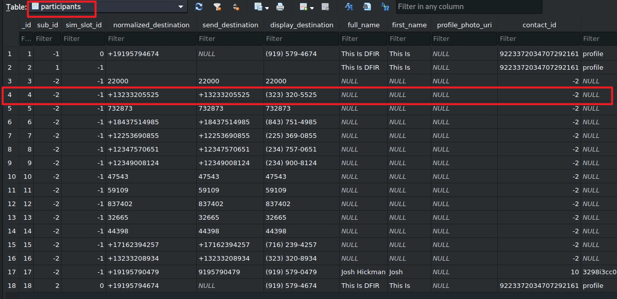
international format
user-friendly format
-2: no contact match

Slide 29
Seen: read flag
0: False, message has not been seen
1: True means its has been seen
Has the message been read?

Slide 30
To summarize
Understand the application
Look at the application directories
Go to the "databases" directory
Open bugle_db
Explore these tables: messages, conversations, participant
Fetch the information needed from these tables

